Slide 1
Resisting Evil
and
Finding Intimacy with God

Slide 2
thegardenworshipcenter.com
Resist Temptation
Romans 13.14 HCSB: “…put on the Lord Jesus Christ, and make no plans to satisfy the fleshly desires.”
Commit to submit to Christ in all things!
Flee temptation!
Call a friend for help!
Pray and resist in God’s strength!

Slide 3
Resist Distraction
Luke 10.38-40 NET: “Jesus entered a certain village where a woman named Martha welcomed him as a guest. She had a sister named Mary, who sat at the Lord's feet and listened to what he said. But Martha was distracted with all the preparations she had to make…”
 Weed out good things
that hold you back from
what is better from God.
thegardenworshipcenter.com

Slide 4
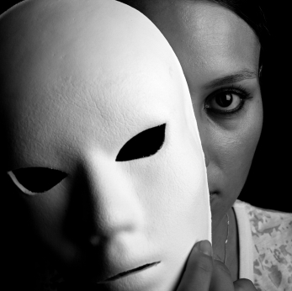
alanvincent.com
Resist Deception
1 Corinthians 15.33 NASB: “Do not be deceived: ‘Bad company corrupts good morals.’”
Beware of deception from…
friends, false teachers, flesh, demons

Slide 5
Resist Accusation
John 13.2 NET: “… the devil had already put into the heart of Judas Iscariot, Simon's son, that he should betray Jesus.”
Take every thought captive in the name of Christ.
Counter lies with scriptural truth.

Slide 6
Resist loving the world 1 John 2.15-17 NET:
“Do not love the world or the things in the world. If anyone loves the world, the love of the Father is not in him, because all that is in the world (the desire of the flesh and the desire of the eyes and the arrogance produced by material possessions) is not from the Father, but is from the world. And the world is passing away with all its desires, but the person who does the will of God remains forever.”
astonmartin.com

Slide 7
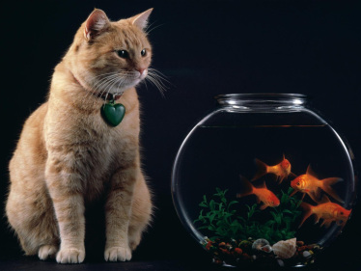
Resist the urges of the flesh
Galatians 5.16-17 NET: “But I say, live by the Spirit and you will not carry out the desires of the flesh. For the flesh has desires that are opposed to the Spirit, and the Spirit has desires that are opposed to the flesh, for these are in opposition to each other, so that you cannot do what
you want.”
revandy.org

Slide 8
saintsnotsinners.org
Resist spiritual adversaries
1 Peter 5.8-9 NET: “Be sober and alert. Your enemy the devil, like a roaring lion, is on the prowl looking for someone to devour. Resist him, strong in your faith, because you know that your brothers and sisters throughout the world are enduring the same kinds of suffering.”
 Rely on God to empower you!

Slide 9
Resist with all of yourself
Hebrews 12.1-4 NIV: “Consider him who endured such opposition from sinners, so that you will not grow weary and lose heart. In your struggle against sin, you have not yet resisted to the point of shedding your blood.”
Tissot

Slide 10
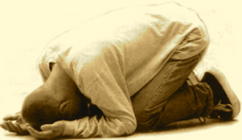
Reasons to Confess
Desire to stay in close relationship with God despite sinful mistakes.
Holy Spirit brings conviction to us that we have sinned and need to confess.
Spiritual friends confront us about our sin and encourage us to confess.
God’s Word says confession is important.

Slide 11
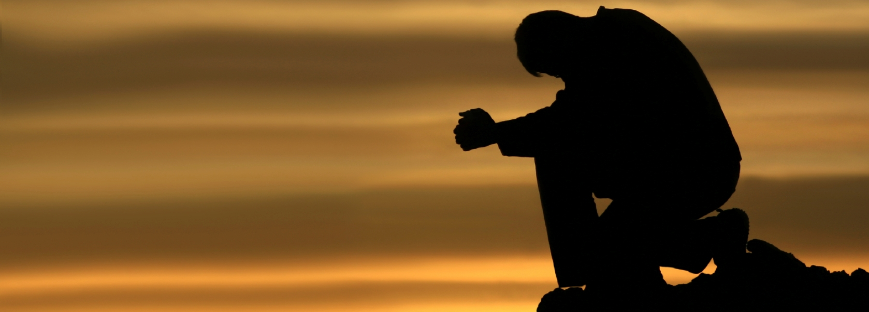
issacharinitiative.org
ὁμολογέω
“say the same thing”
1 John 1.9 NASB: “If we confess our sins, He is faithful and righteous to forgive us our sins and to cleanse us from all unrighteousness.”
to restore our relationship with him

Slide 12
issacharinitiative.org
ὁμολογέω
“say the same thing”
1 John 1.9 NASB: “If we confess our sins, He is faithful and righteous to forgive us our sins and to cleanse us from all unrighteousness.”
to restore our relationship with him
Romans 8.1 NASB: “Therefore there is now no condemnation for those who are in Christ Jesus.”

Slide 13
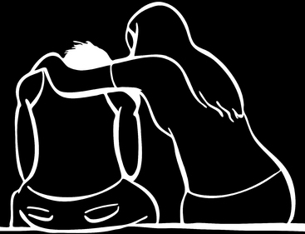
James 5.16 NASB: “Therefore, confess your sins to one another, and pray for one another so that you may be healed. The effective prayer of a righteous man can accomplish much.”
churchwhisperer.com

Slide 14
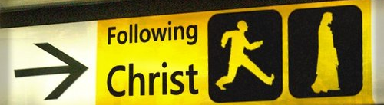
trinityagchurch.in
Obedience shows love for God
1 John 5.3 HCSB: “For this is what love for God is: to keep His commands.”
John 14.15 NET: [Jesus speaking] “If you love me, you will obey my commandments.”

Slide 15
Obedience is evidence of our salvation
1 John 2.3-5 NET: “Now by this we know that we have come to know God: if we keep his commandments. The one who says "I have come to know God" and yet does not keep his commandments is a liar, and the truth is not in such a person. But whoever obeys his word, truly in this person the love of God has been perfected. By this we know that we are in him.”

Slide 16
Obedience makes us available to God
2 Timothy 2.21 HCSB: “So if anyone purifies himself from anything dishonorable, he will be a special instrument, set apart, useful to the Master, prepared for every good work.”

Slide 17
Obedience pleases God rather than grieving him
Ephesians 4.30 NASB: “[Do not sin.] Do not grieve the Holy Spirit of God, by whom you were sealed for the day of redemption.”

Slide 18
Effects of sin for Christians
Earthly human consequences
Earthly corrective action from God
Physical illness
Suffering in conscience
Deception of the mind, hardening of the heart
Spiritual bondage to sin
Loss of peace, joy, and other fruit of the Spirit
Loss of heavenly treasure
Loss of earthly blessings
Negative effects on other people.

Slide 19
Avoid attitude of license / toleration of sin
Romans 6.15 NIV: “Shall we sin because we are not under the law but under grace? By no means!”

Slide 20
Avoid attitude of license / toleration of sin
Romans 6.15 NIV: “Shall we sin because we are not under the law but under grace? By no means!”
Avoid attitude of legalism
Galatians 5.1 NET: “For freedom Christ has set us free. Stand firm, then, and do not be subject again to the yoke of slavery.”

Slide 21
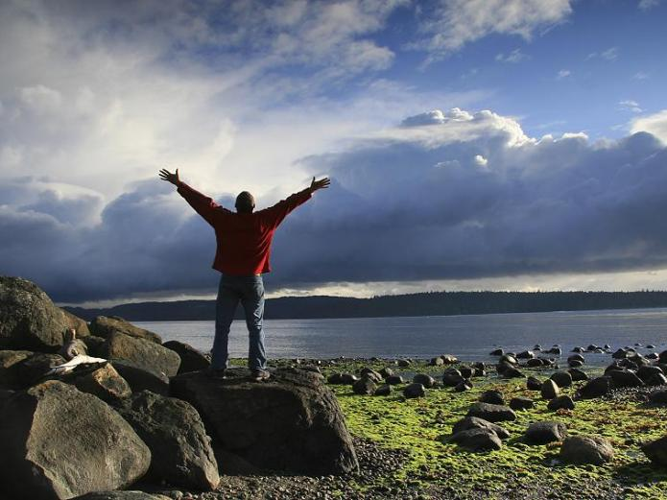
Rejoice in being under
the New Covenant with God!
drewcuster.wordpress.com

Slide 22
Intimacy with God
1 John 1.5b-6 NET:
“God is light, and in him
there is no darkness at all.
If we say we have
fellowship with him and yet keep on walking in the darkness, we are lying and not practicing the truth.”
John 14.21 NET: “The person who has my commandments and obeys them is the one who loves me. The one who loves me will be loved by my Father, and I will love him and will reveal myself to him.”
pastorwalt.hubpages.com

Slide 23
blood
indwelling
grace
submit
yield
fruit of the Spirit
filling
be led
appropriate
resist
confess
obey
intimacy

